Slide 1


Parallel Programming
Santosh Shrestha

Slide 2

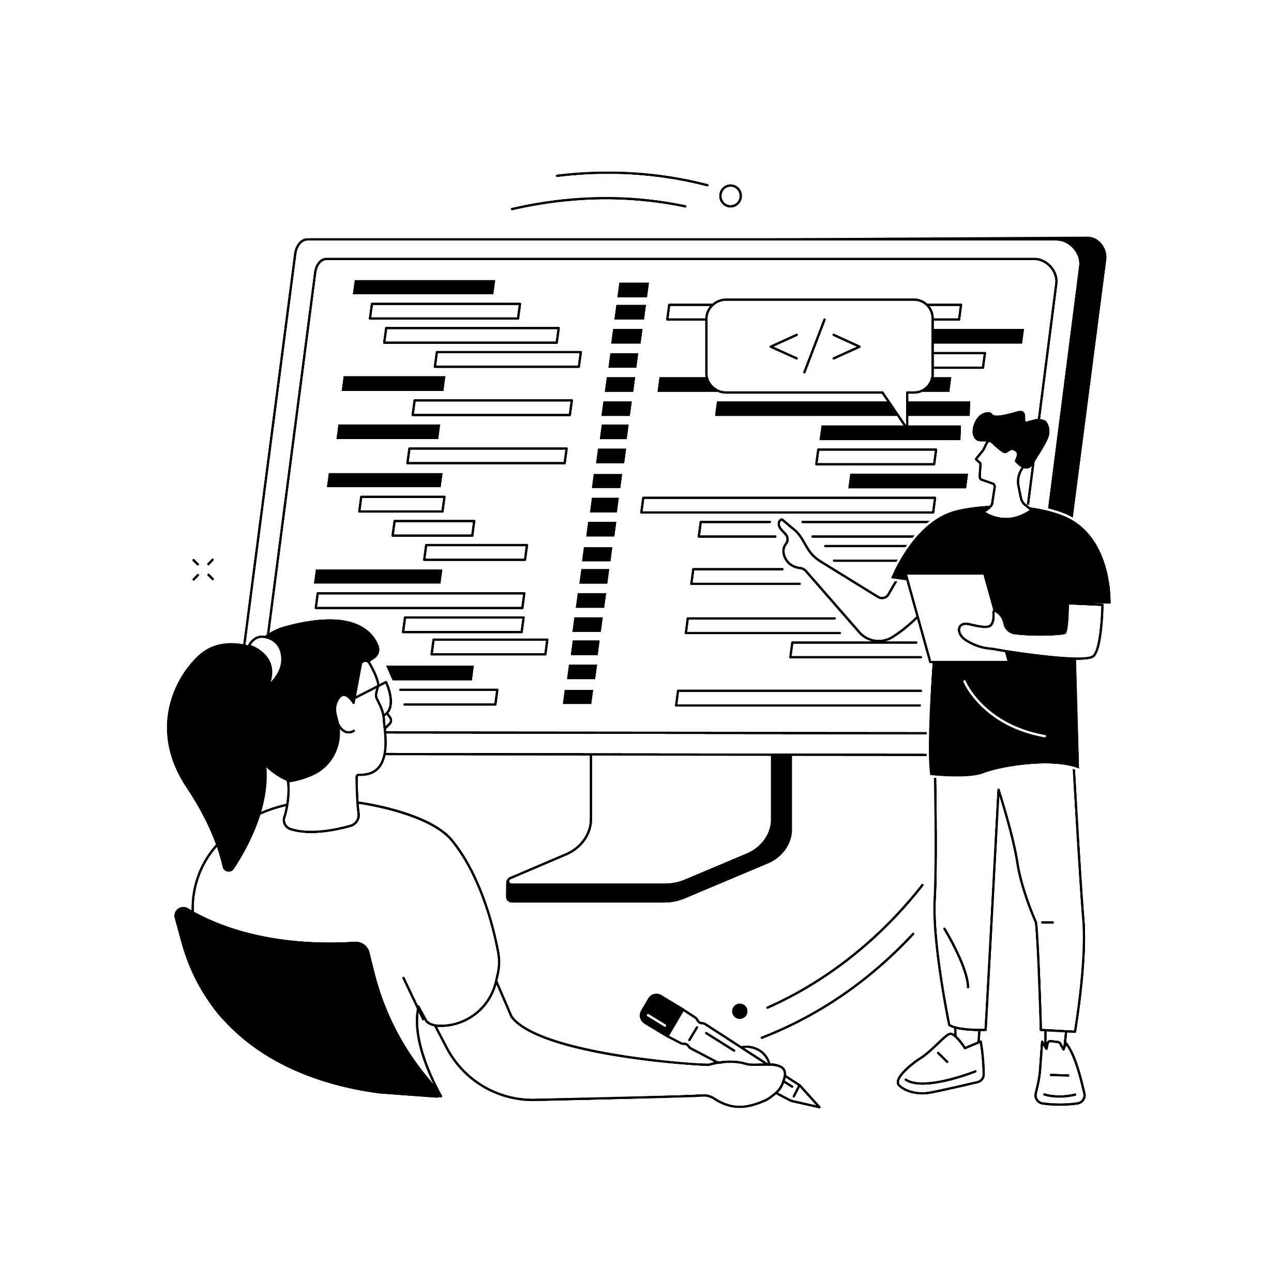

Introduction
Flow of application broken down into pieces.
Executes multiple instructions at the same time.
Multi Thread
Task Parallel Library (TPL)
Parallel Invoke
“Going Parallel is not a cure for everything”

Slide 3

Things To Remember
Additional Overhead.
Needs to manage all features. (Hardware, Application behaviour)
Data Coordination.
Needs to take extra care on invoking shared resources.
Scaling
Should have good understanding of hardware.
Increasing the CPU core will not enhance performance.

Slide 4
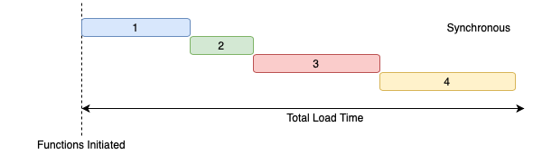
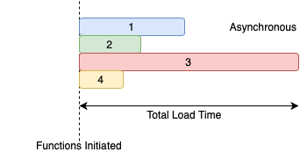
Asynchronous Programming
Mean to parallel programming.
Runs in separate thread than application thread.
Notifies the calling (application thread) on completion or failure of process.
Rules
Method signature must have async keyword.
Method name should end with Async (Naming Convention).
Method should return Task or Task<T>
Method should await.

Slide 5

Parallel Programming
Asynchronous programming running in separate task.
Can execute multiple synchronous or asynchronous method in multiple tasks.
When sharing same resource, the calling thread should be invoked to alter the values associated.
Helps to improve performance on long running tasks.

Slide 6


Thank You

